Slide 1
STOCK DATA ANALYSIS
Created by: Matt Rivas, Jeremy Brown, Dana Smith

Slide 2

Mission
To predict future closing process for TSLA and AAPL stock, through GRU, Q Learning and LSTM models.

Slide 3
MOdel, clean up & training
Summary
We imported 12 years of TSLA stock data & 22 years of AAPL stock data.
After looking at some of the graphs, we determined it was more efficient to analyze the last 4 years of TSLA & last 6 years of AAPL
Q Learning model was more based on a plug and play of GAMMA and Epsilon variables. The lower the GAMMA and the higher the GAMMA the worse the total rewards were
We found a sweet spot in the 70% range.
In our LSTM model:
We adjusted the training & testing percent between 70 - 90%
Adjusted epochs & batches
GRU model:
Examples of training and clean up processes
Attempted to predict pricing of stocks using historical data

Slide 4
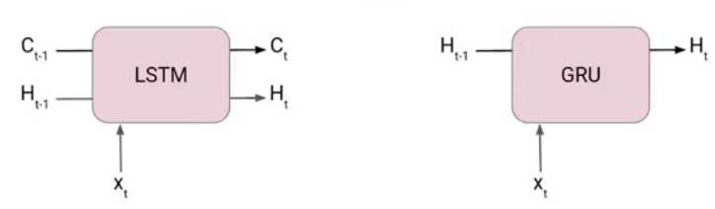
GRU - Gated Recurrent Unit
This is a specific model of recurrent neural network (RNN) that intends to use connections through a sequence of nodes to perform machine learning tasks associated with memory and clustering
Similar to LSTM, GRU models are used to address the vanishing gradient problem through gates.
https://www.analyticsvidhya.com/blog/2021/03/introduction-to-gated-recurrent-unit-gru/

Slide 5
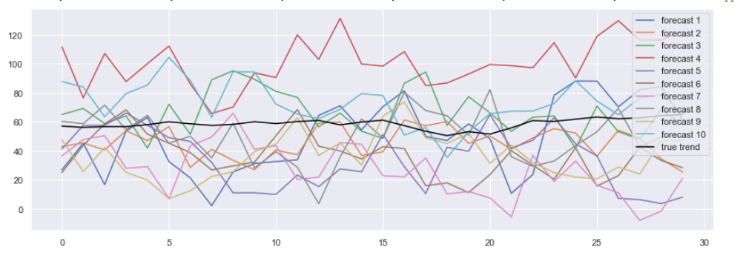
GRU TSLA ANALYSIS
Used 1024 points of historical stock data
Below is the accuracy graph of the training model.
As we can see, GRU did a poor job anticipating price movement.
This poor performance can be explained by lack causality ie yesterdays stock price does not influence the stock price in the future

Slide 6
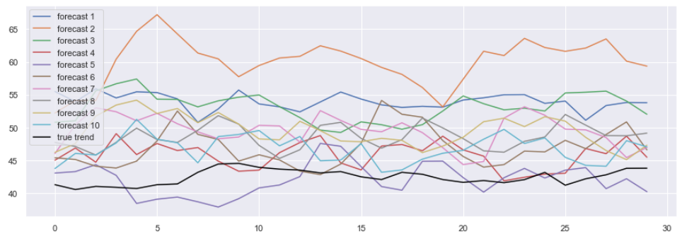
AAPL GRU Analysis
While the true trend of AAPL seems to be more closely correlated to some of the forecasts, the results aren’t predictive enough to be relied upon. Specifically forecast 5 seems to have been the most correlated. Perhaps with more refinement this model could have more accurately predicted AAPL price.

Slide 7
GRU take aways
While similar to LSTM, GRU uses simpler architecture.
This simpler architecture means GRU models are faster and easier to train, however the results may not be as accurate as a comparable LSTM model.
Using the correct model for your data set is essential. Use the right tool for the job, not your favorite tool.

Slide 8
LSTM
Long Short-Term Memory
Similar to GRU model, LSTM was created as a solution to short-term memory or vanishing gradient problems that appear while training RNN’s with long data sequences
Historical & current data are combined
Data is then ran through a layers to sort out non-relevant data and decides what data should be added
LSTM can choose which information is relevant to remember or forget during sequence process

Slide 9
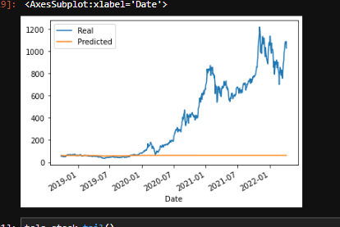
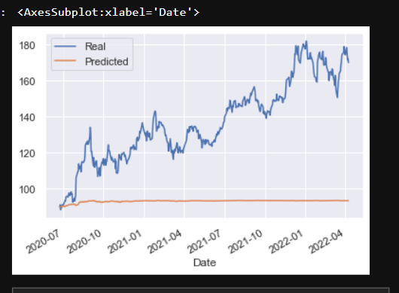
AApl closing price predictions
90% testing/10% training
10 epochs/1 batch
TSLA closing price predictions
70% testing/30% training
10 epochs/1 batch

Slide 10
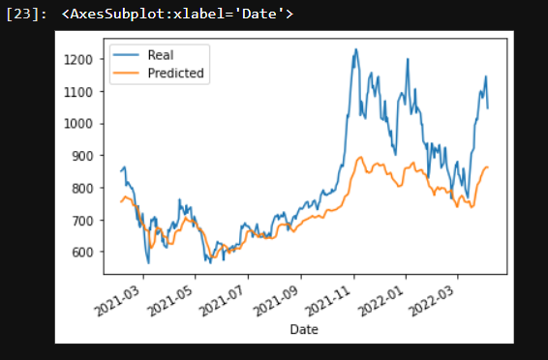
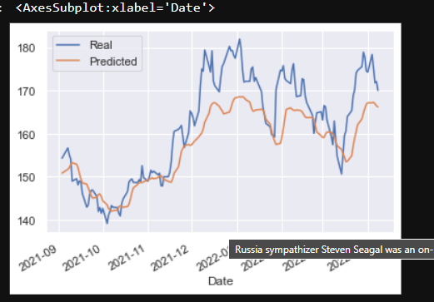
AApl closing price predictions
90% testing/10% training
100 epochs/90batch
TSLA closing price predictions
90% testing/30% training
100 epochs/90 batch

Slide 11
Reinforcement Learning – Q Learning
⦁ Seeks to learn a policy that maximizes its total reward
⦁ A q-table is created to assign values to each state and action as a reference point for it to select its next best action
⦁ Agent interacts with environment and updates q-table to reflect whether or not the reward was positive or negative
⦁ Common variable in Q-Learning models is gamma, or the discount factor, and it helps assess what the future rewards will be
⦁Epsilon is another common variable, and it determines how aggressive or greedy the model will be seeking

Slide 12

Reinforcement LEarning is one of the most beautiful branches in Artificial Intelligence
The objective of RL is to maximize the reward of an agent by taking a series of actions in response to a dynamic environment.
There are 4 basic components in Reinforcement Learning: agent, environment, reward and action.

Slide 13
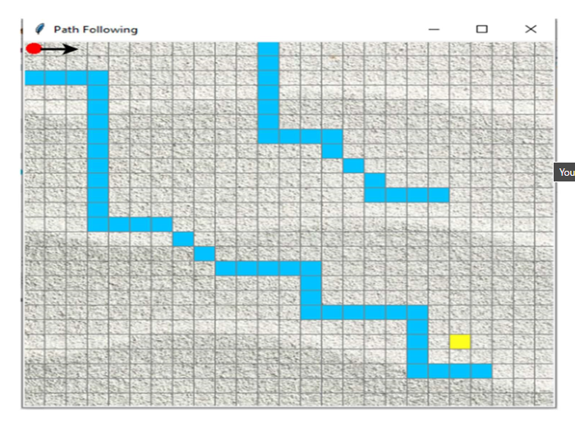

Slide 14
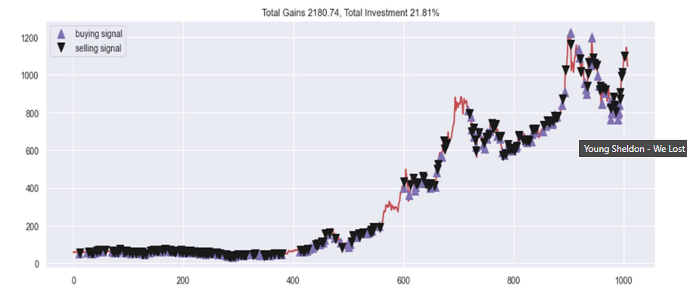
TSLA Stock Analysis

Slide 15
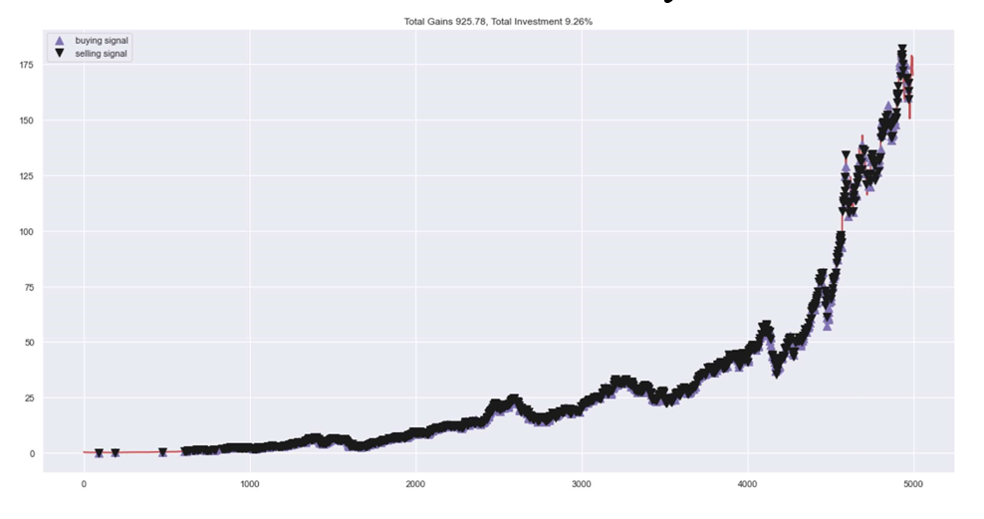
AAPL Stock Analysis

Slide 16
Stock Data Analysis Conclusion
If we had more time, we would have done a social media anaylsis to determine if certain keywords affected the stock prices in a positive or negative manner
We would have created a Dashboard if we had more time
Q-Learning model predicited whether it would be a buy or sell, while GRU & LSTM were used to help predict pricing fluctuations.
Q-Learning AAPL model averaged at 9% and TSLA earning 21%, which we would be better buying and holding until the end.
Historical stock data is not predictive of future stock prices, which is why LSTM & GRU were not good predictive models.

